Slide 1

Basics in Computational Methods in Biotechnology
Case Study 1
Vyshnavi Arunkumar(03803119)
Deepa Ramakrishnan Subathra(03799043)
Om Mihani(03803669)
17.12.2025

Slide 2
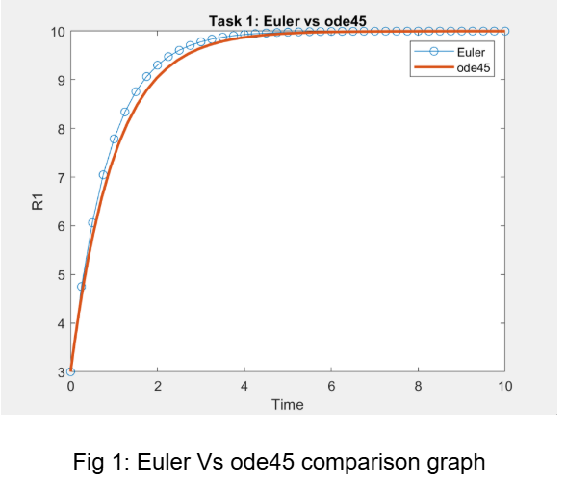
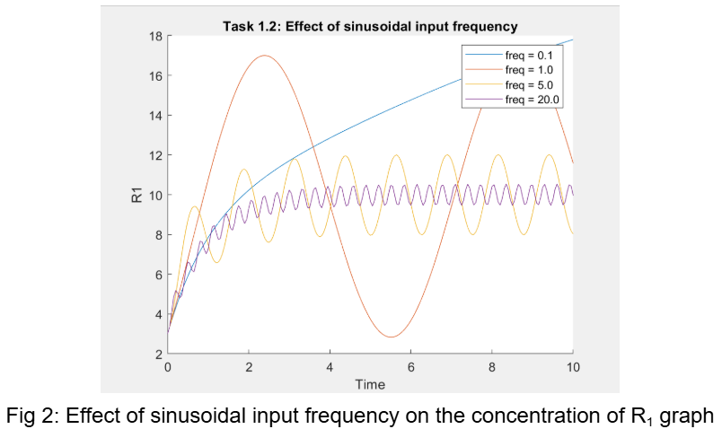
TASK 1

Slide 3
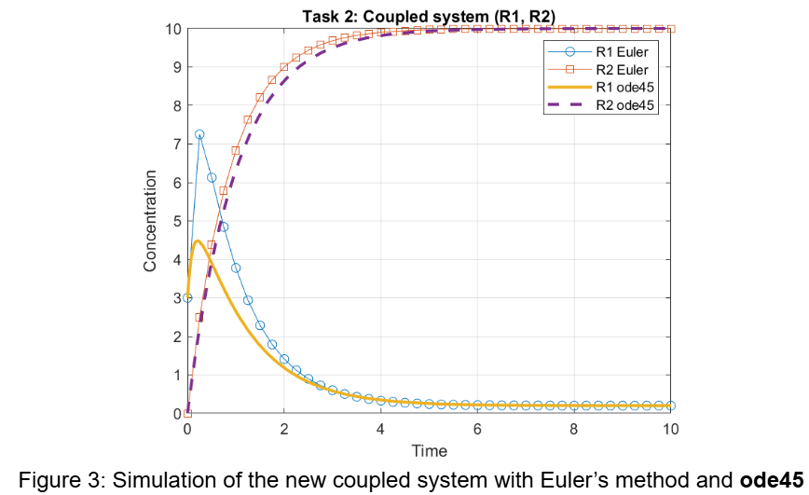
TASK 2

Slide 4
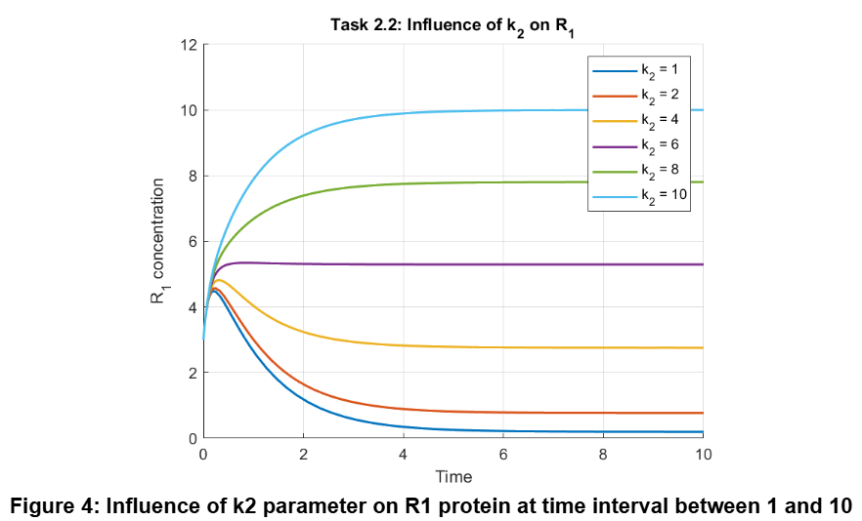
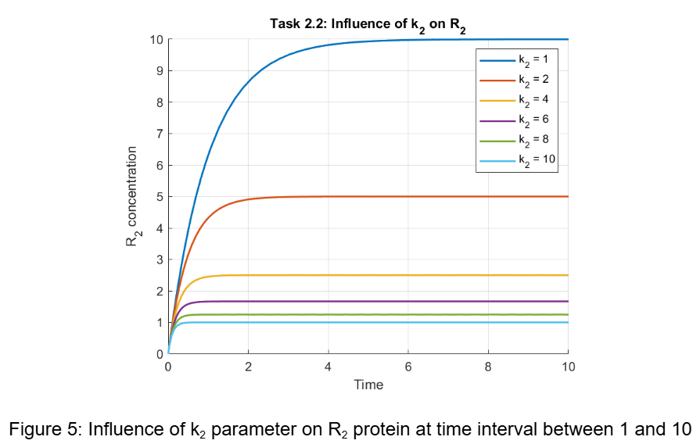
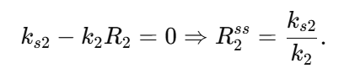
TASK 2
Steady-state concentration of $R_{2}:$

Slide 5
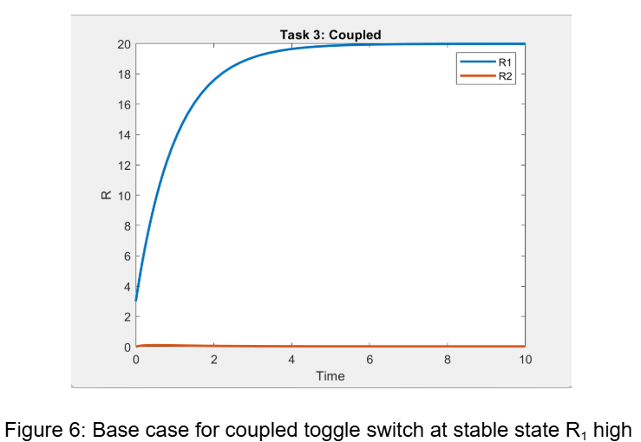
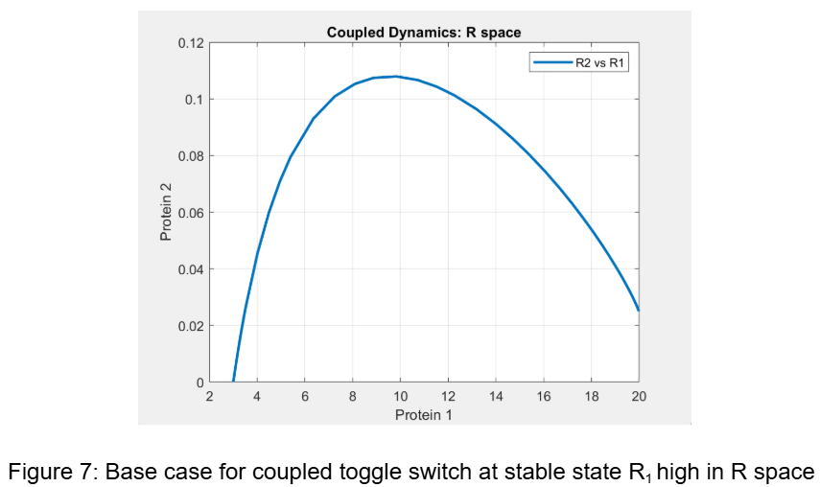
TASK 3

Slide 6
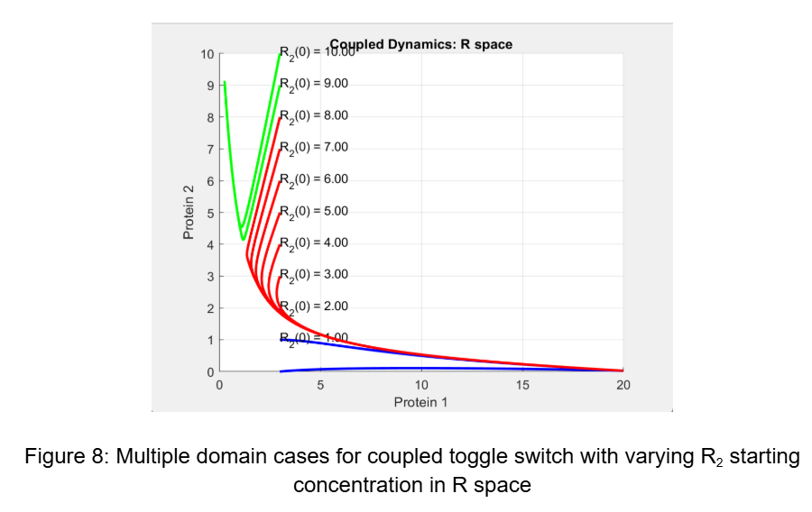
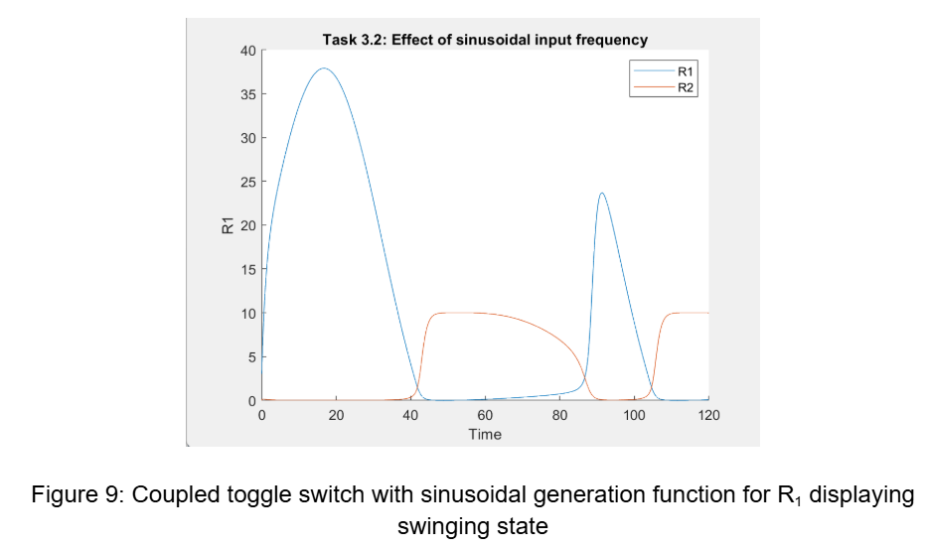
TASK 3

